Slide 1
ANGULAR

Slide 2
Angular is a platform and framework for building client-side applications using HTML, CSS, and JavaScript/TypeScript. Developed and maintained by Google, Angular is a complete rewrite of AngularJS and is designed for developing dynamic web applications with a modern, component-based architecture.

Slide 3
Key Features of Angular
Component-Based Architecture: Encourages modular development with reusable components.
Dependency Injection: Facilitates better organization and management of services and dependencies.
Data Binding: Supports one-way and two-way data binding for seamless data synchronization between model and view.
Directives: Extend HTML with custom attributes and elements.
Services and DI: Enable shared logic and functionality across components.
Routing: Powerful navigation and routing capabilities for single-page applications.
Forms Handling: Robust support for reactive and template-driven forms.

Slide 4
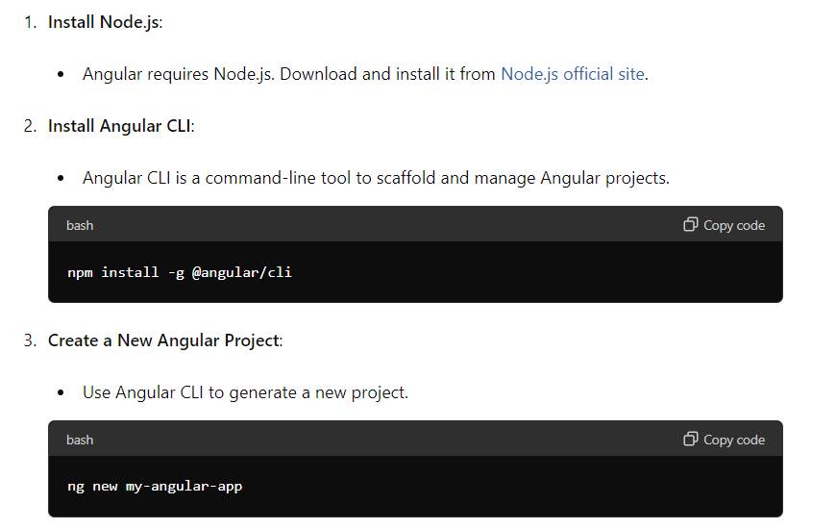
Steps to Install Angular

Slide 5
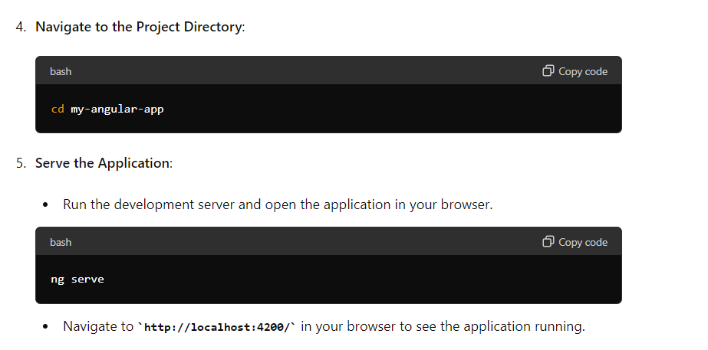

Slide 6
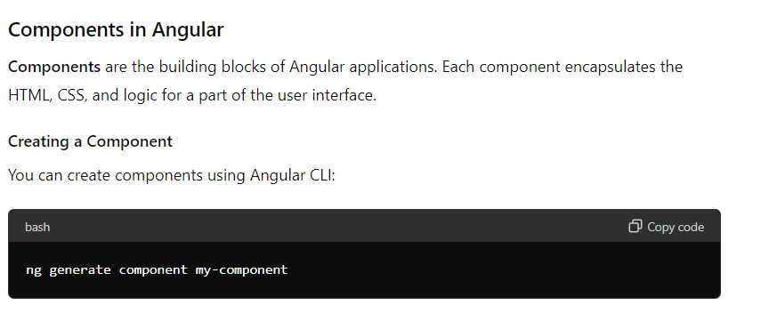
Components in Angular

Slide 7
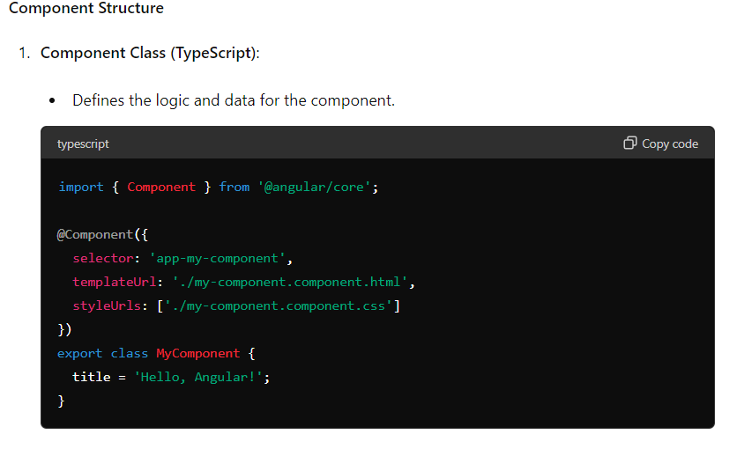

Slide 8
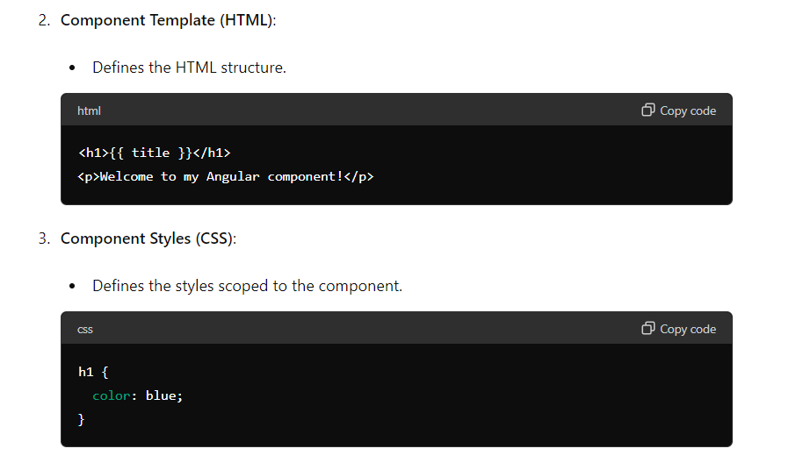

Slide 9
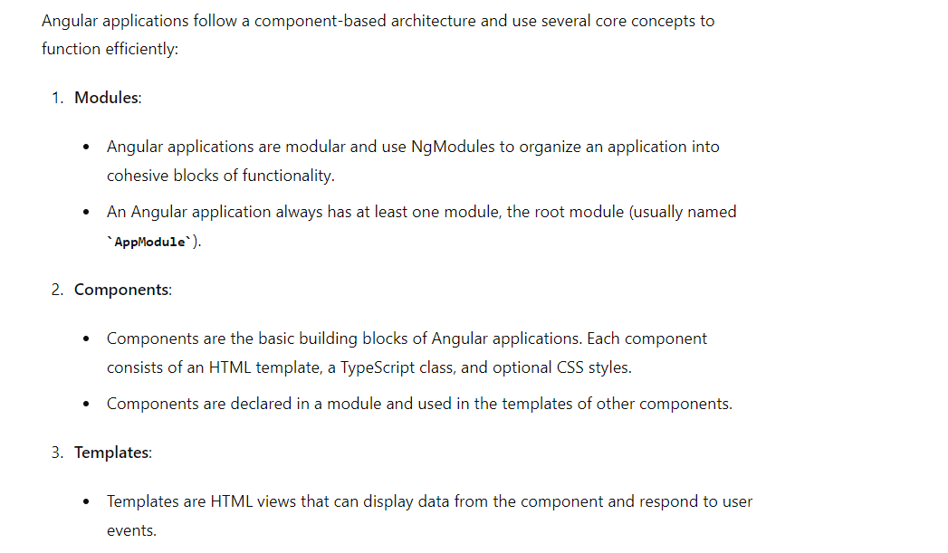
How Angular Works

Slide 10


Slide 11
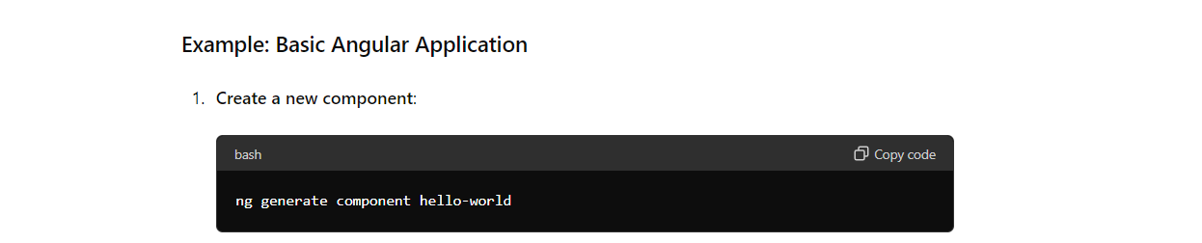

Slide 12
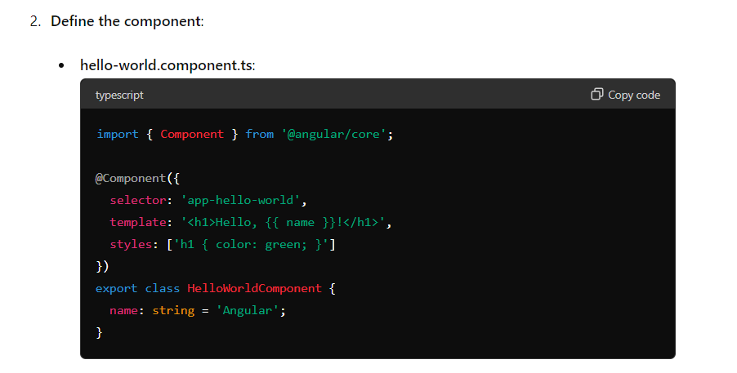

Slide 13
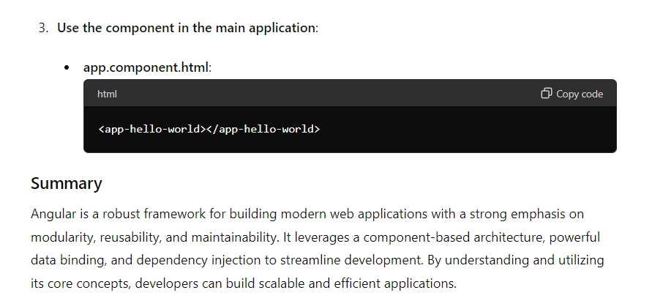

Slide 14
Binding in Angular
Binding in Angular refers to the process of connecting the data in a component to the view (HTML template) and vice versa. It enables the synchronization of data between the component class and the template, allowing for dynamic and interactive applications. There are several types of data binding in Angular:

Slide 15
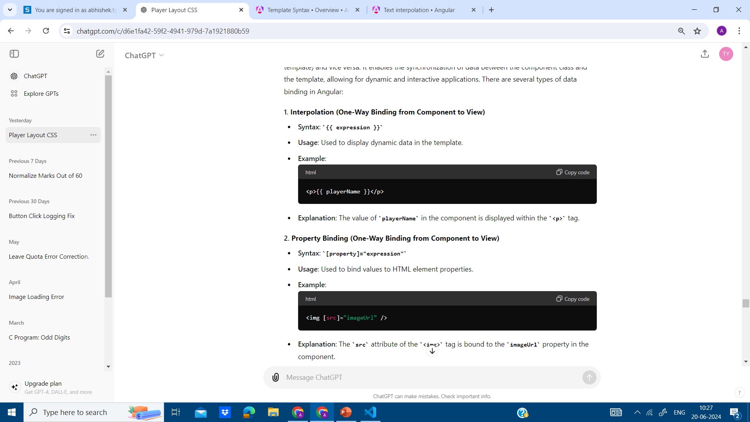

Slide 16
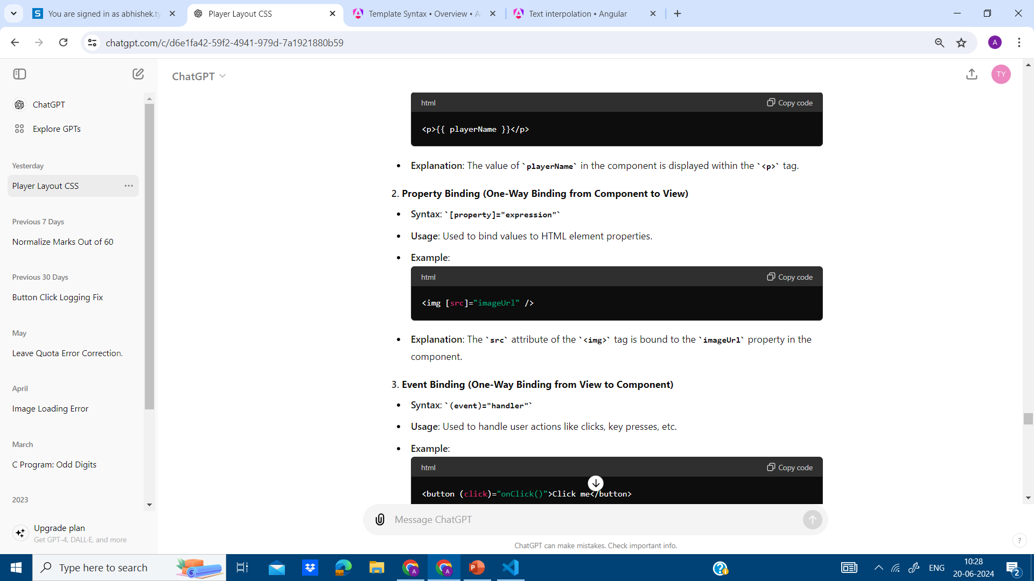

Slide 17
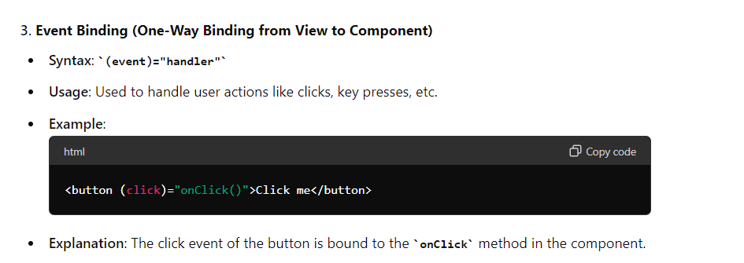

Slide 18
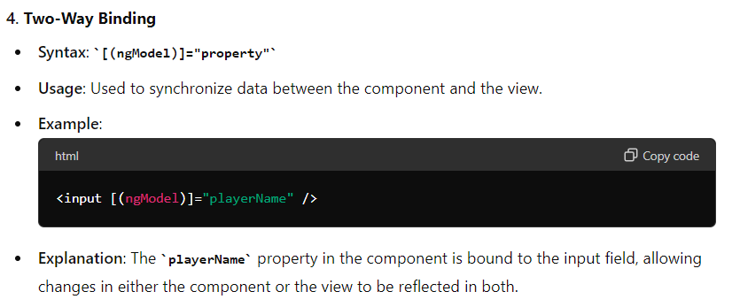

Slide 19
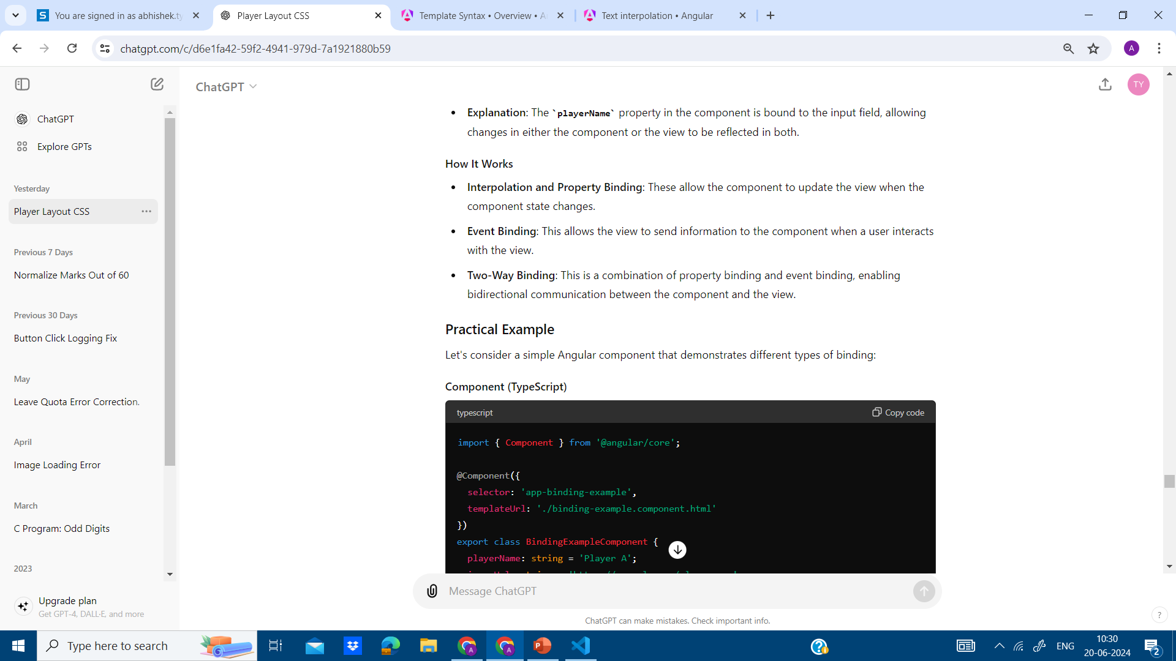

Slide 20
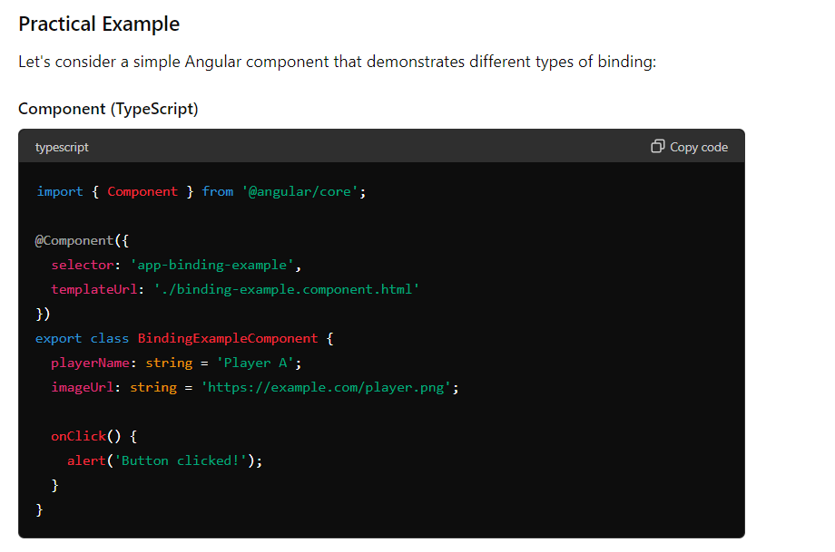

Slide 21
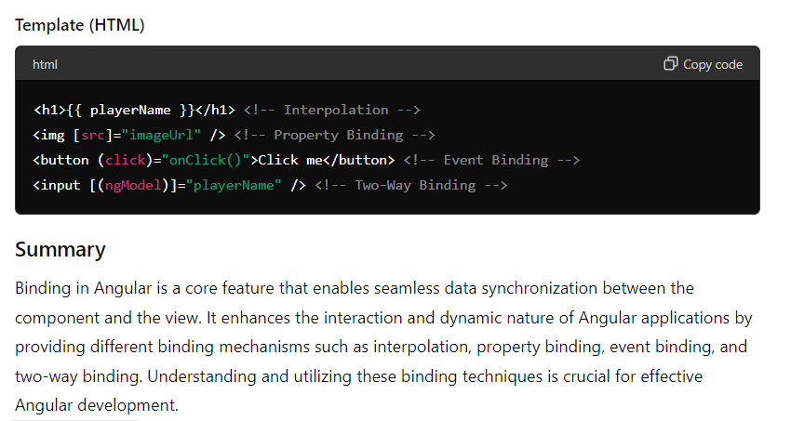

Slide 22
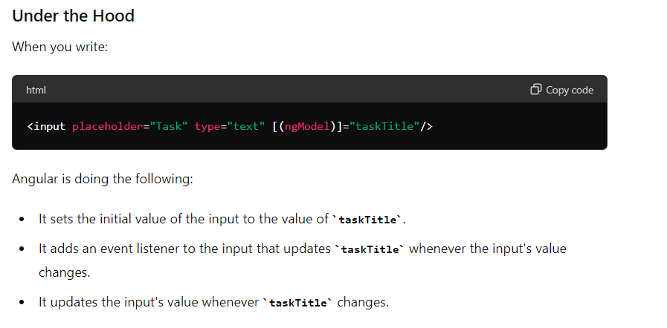

Slide 23
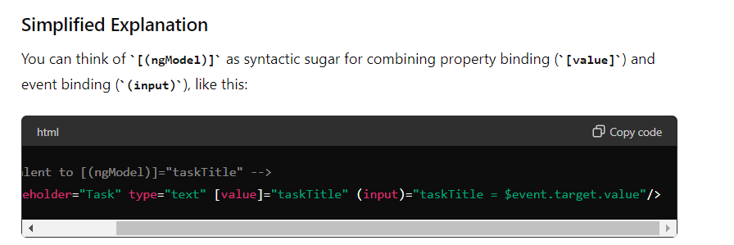

Slide 24
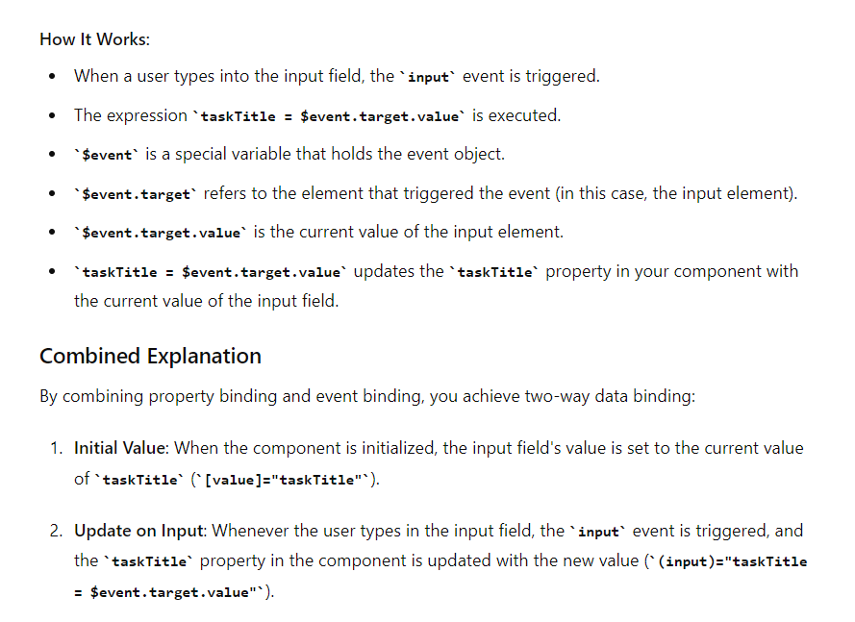

Slide 25
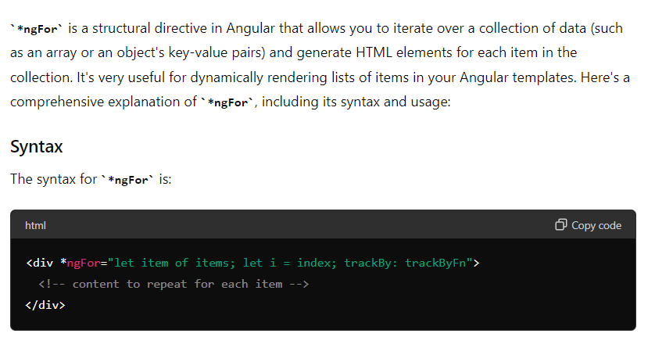

Slide 26
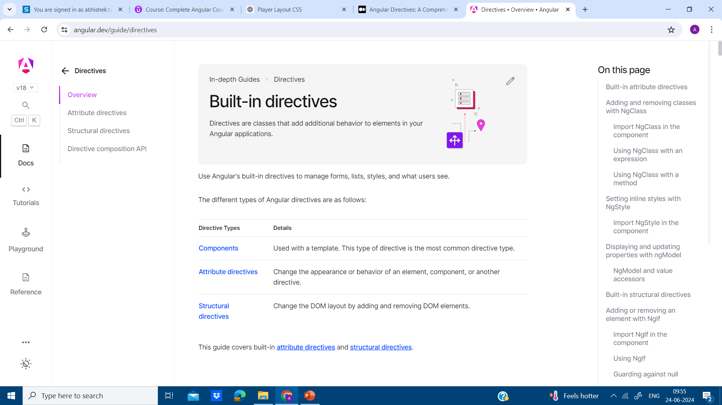

Slide 27
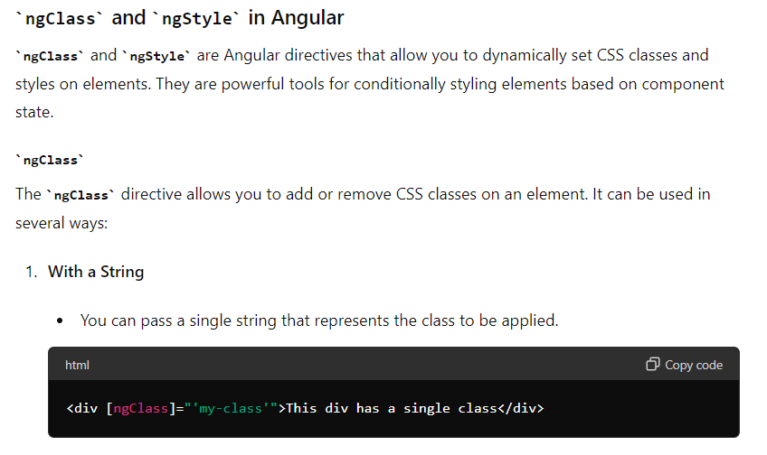

Slide 28
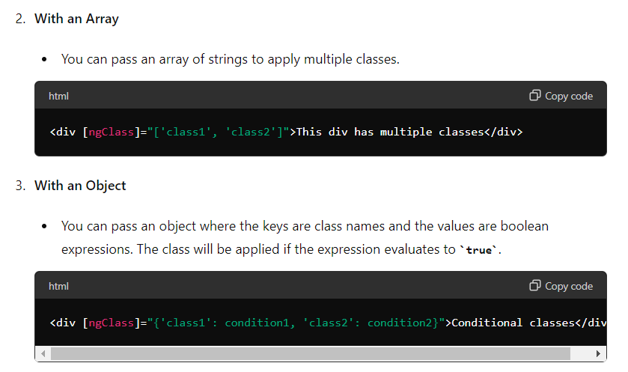

Slide 29
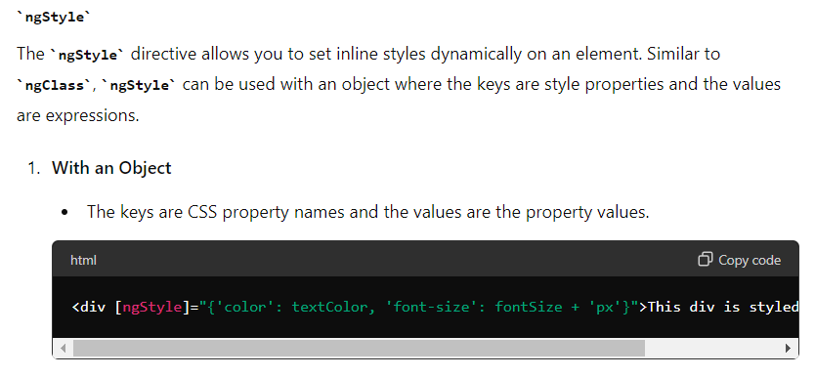

Slide 30
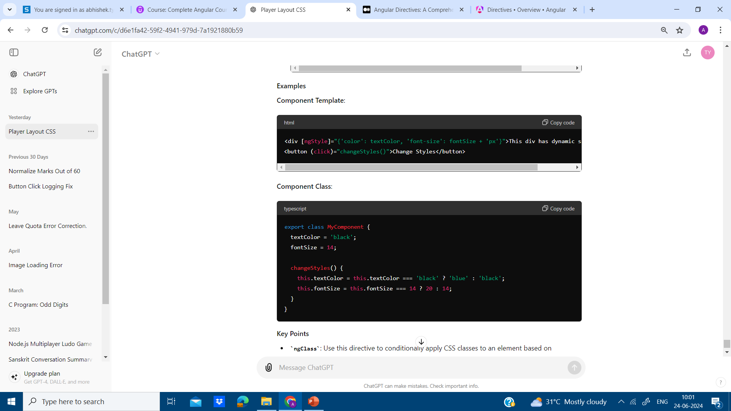

Slide 31
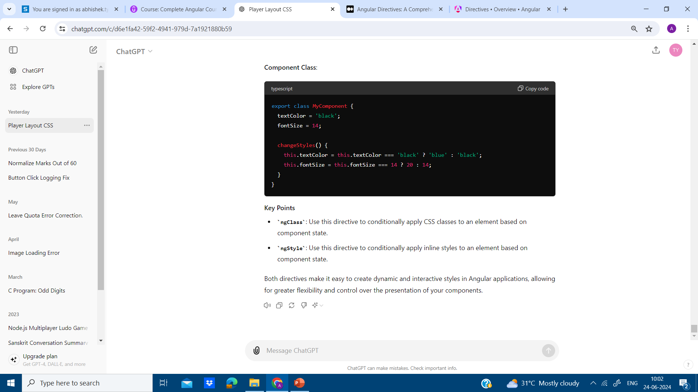

Slide 32
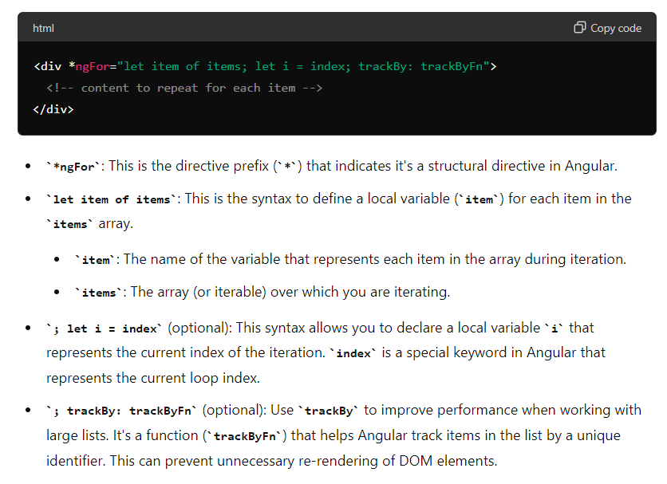

Slide 33
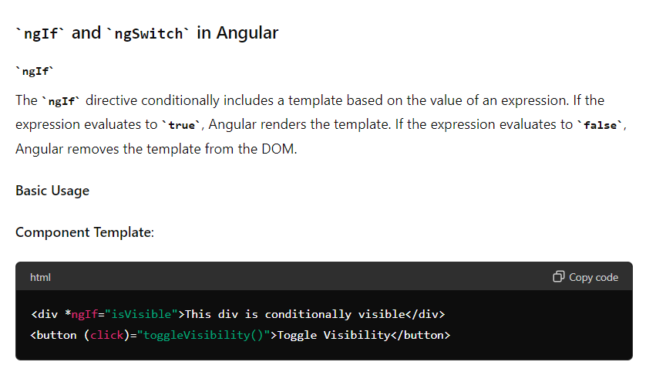

Slide 34
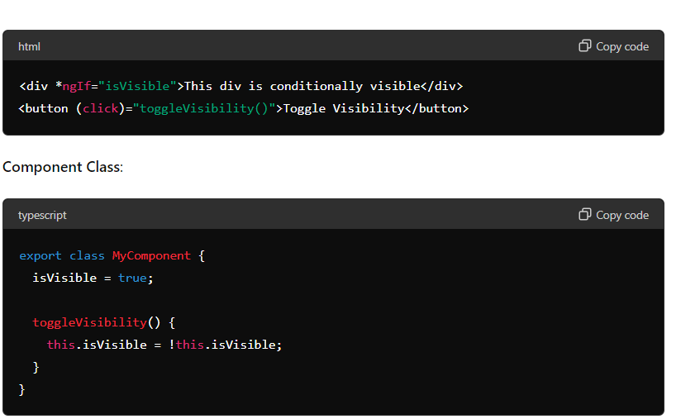

Slide 35
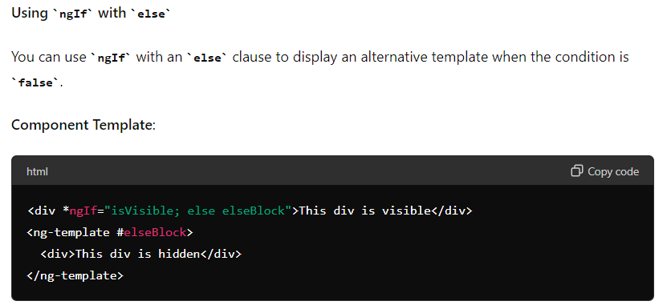

Slide 36
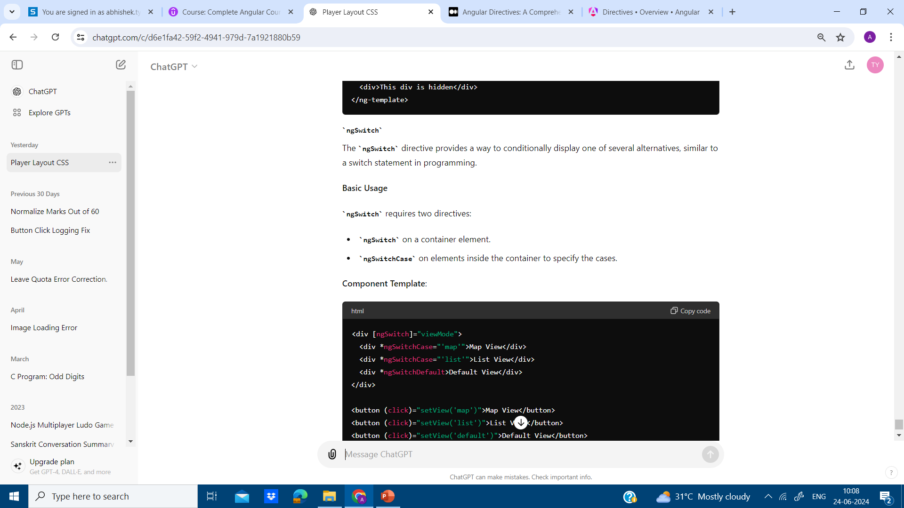

Slide 37
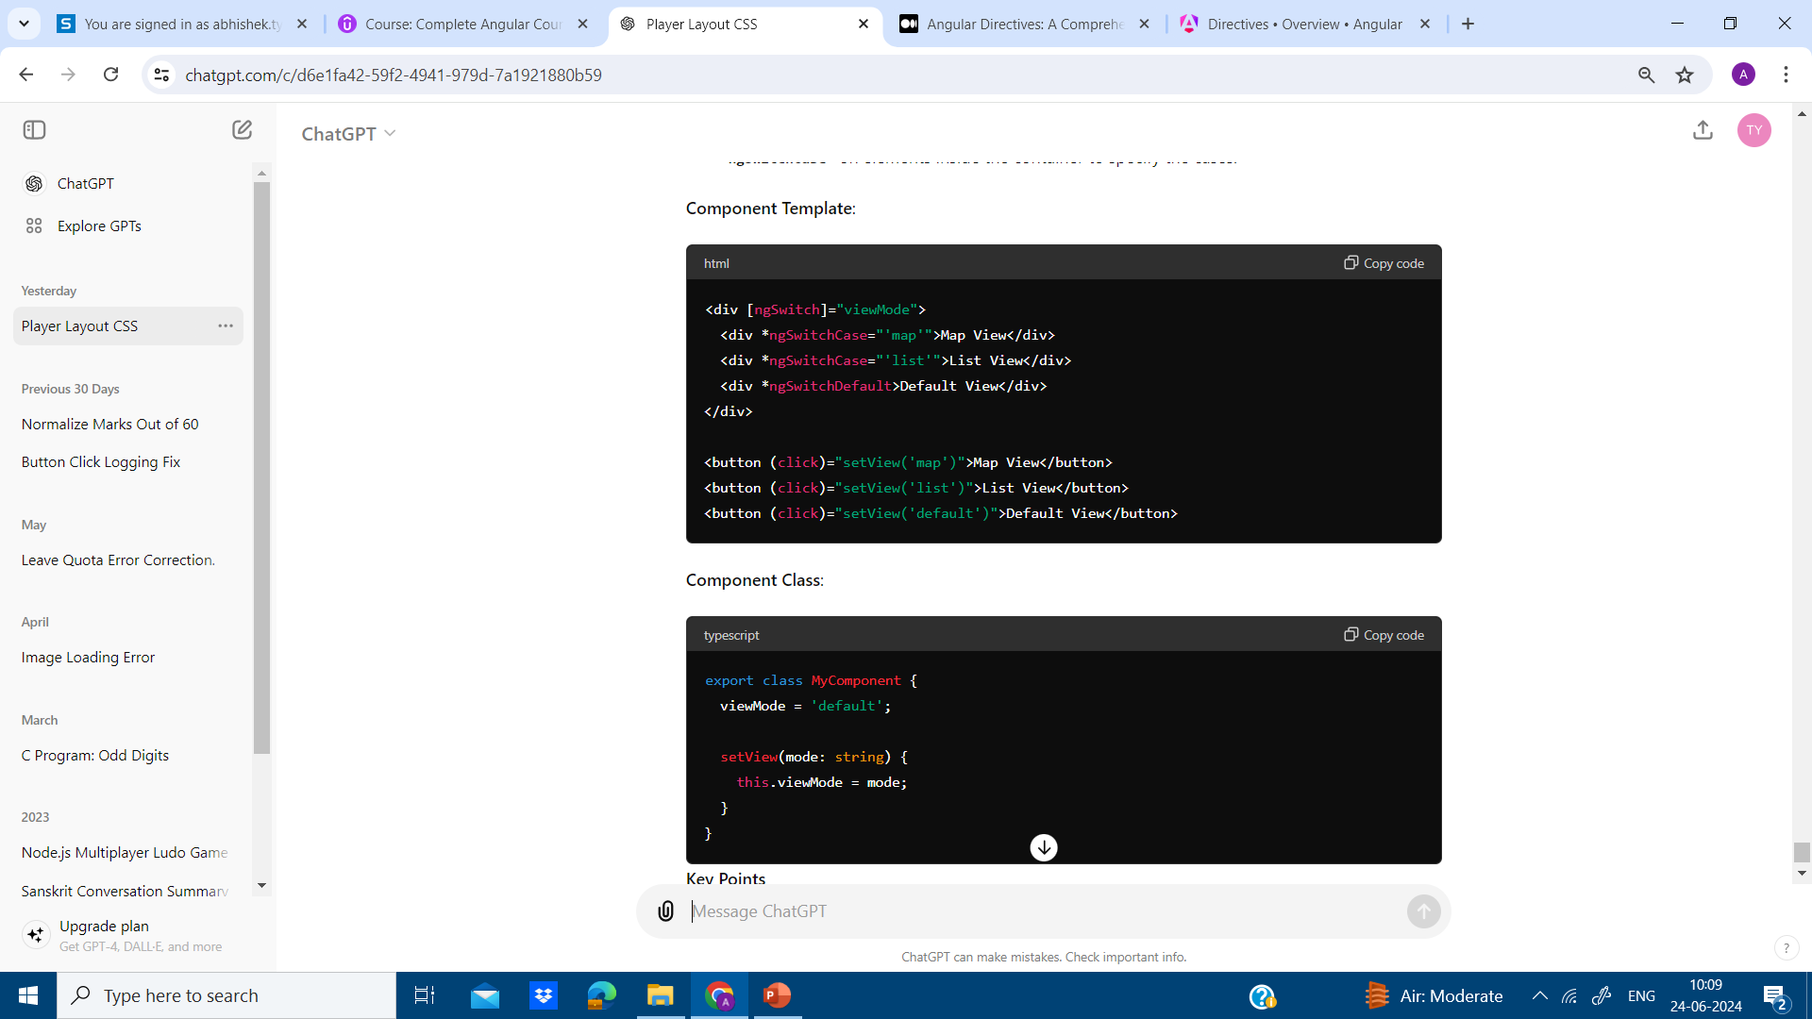

Slide 38
ANGULAR LIFE CYCLE HOOKS
In Angular, lifecycle hooks are special methods that get called at specific points in the life of a component or directive. These hooks provide developers with a way to tap into key events in the lifecycle of Angular components and directives, allowing them to execute custom logic at each stage. Here’s a detailed explanation of the most commonly used lifecycle hooks:

Slide 39
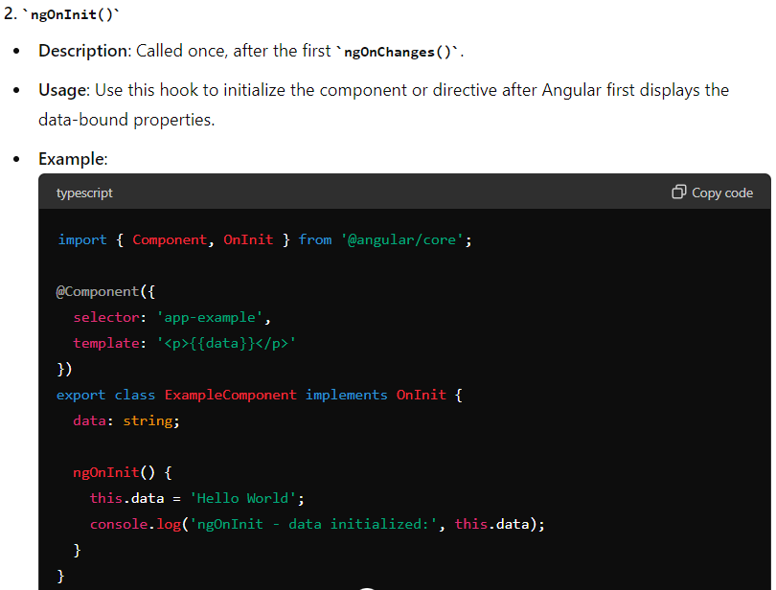

Slide 40
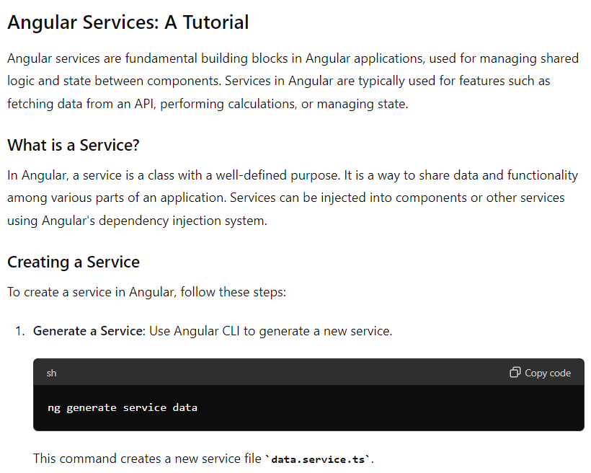

Slide 41
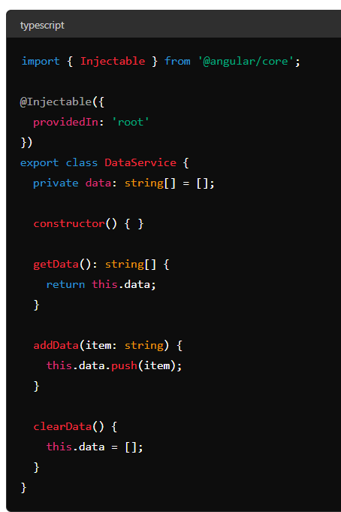

Slide 42
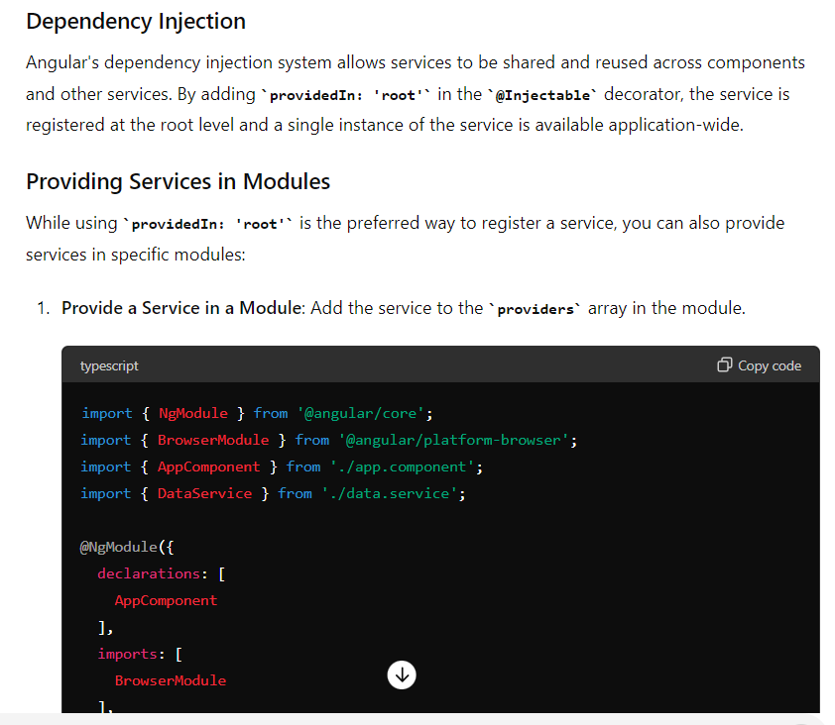

Slide 43
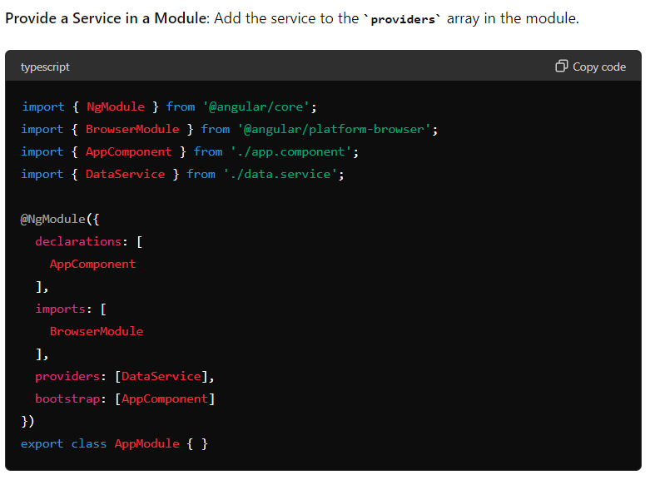

Slide 44
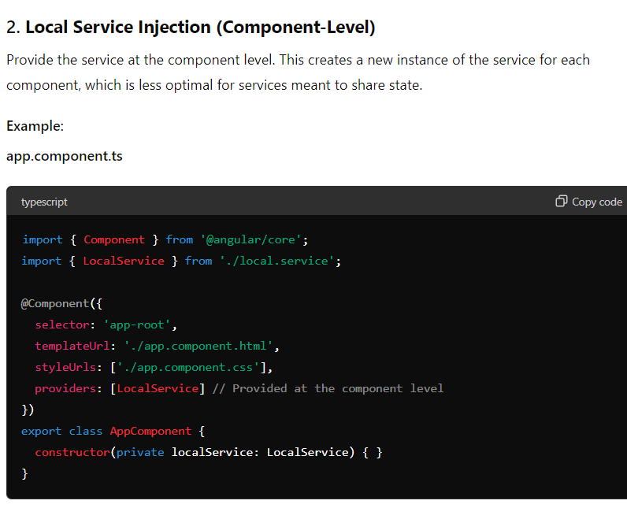

Slide 45
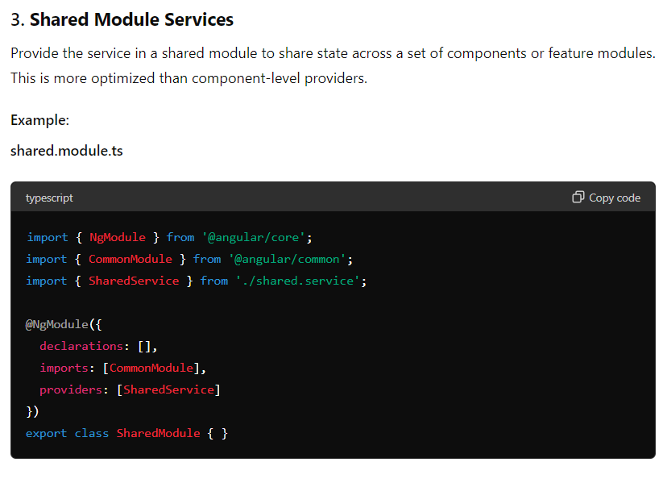

Slide 46
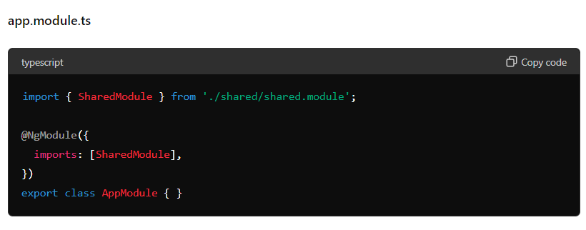

Slide 47
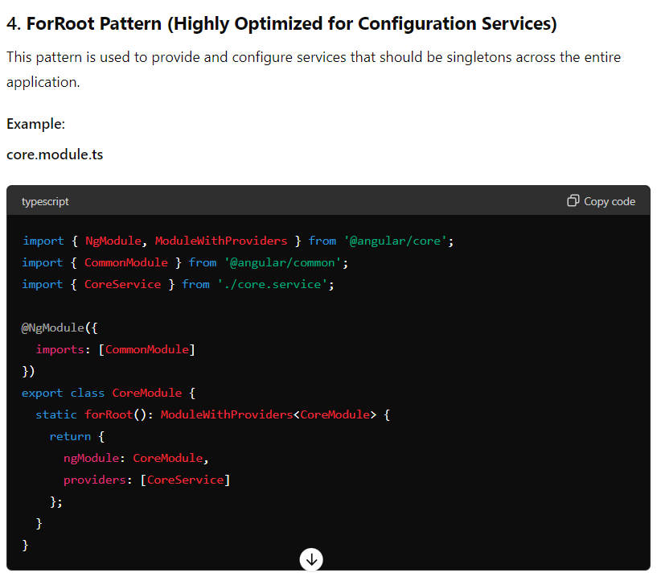

Slide 48
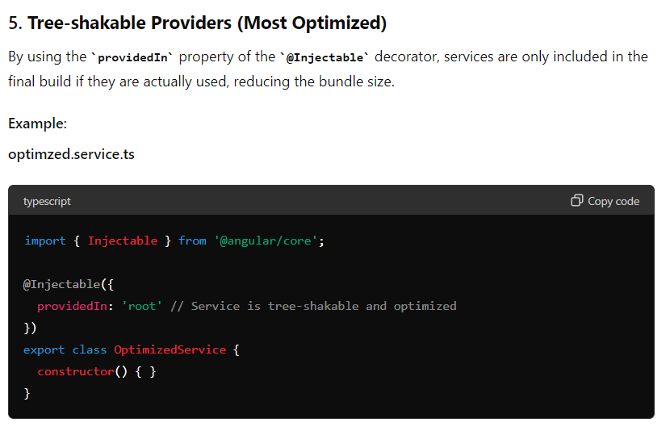

Slide 49
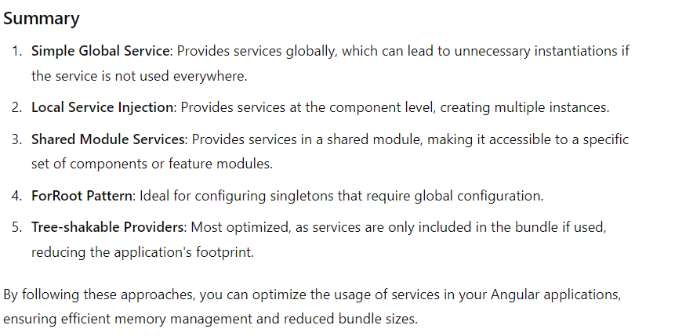

Slide 50
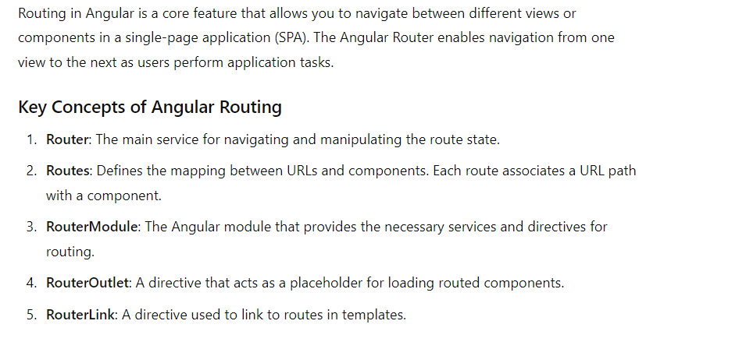

Slide 51
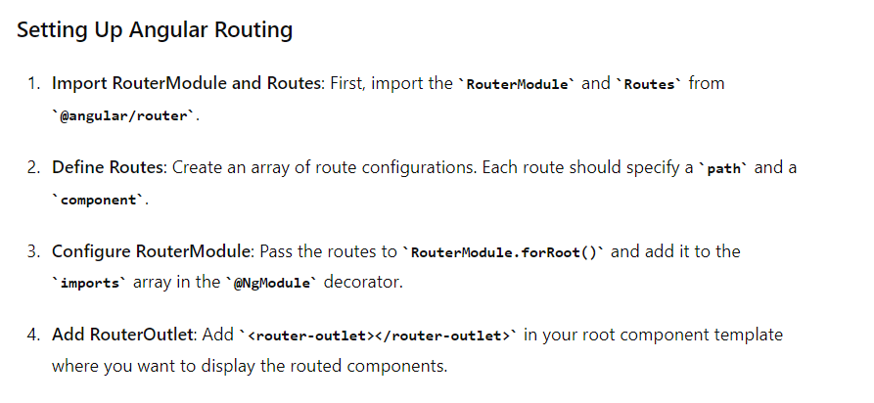

Slide 52
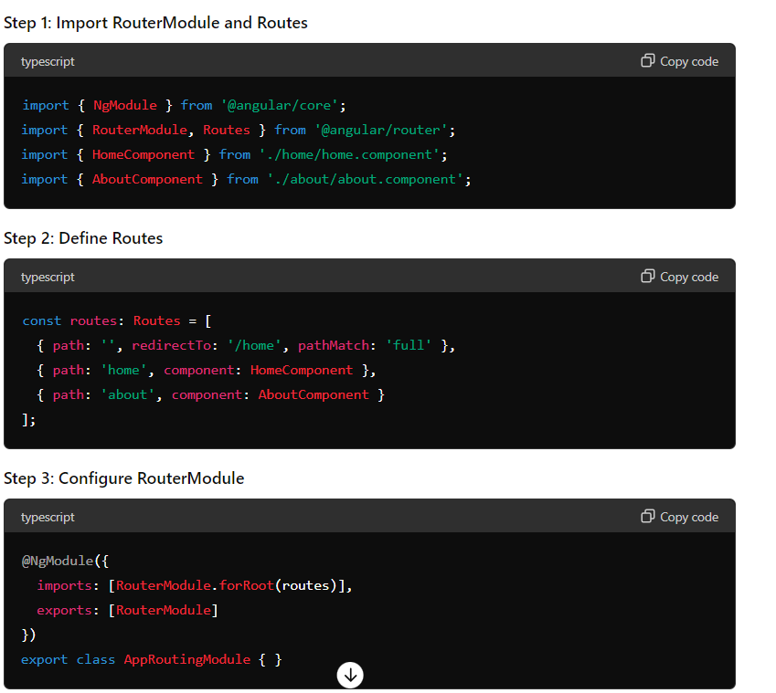

Slide 53
